Slide 1
SDSC 3006 Lab 1. Introduction to R
Name: Yiren Liu
Email: yirenliu2-c@my.cityu.edu.hk
School of Data Science
City University of Hong Kong

Slide 2
Outline
Install R, and R Studio as IDE
Install data packages
Basic commands
Example of preliminary analysis of a dataset

Slide 3
Install R, R Studio

Slide 4
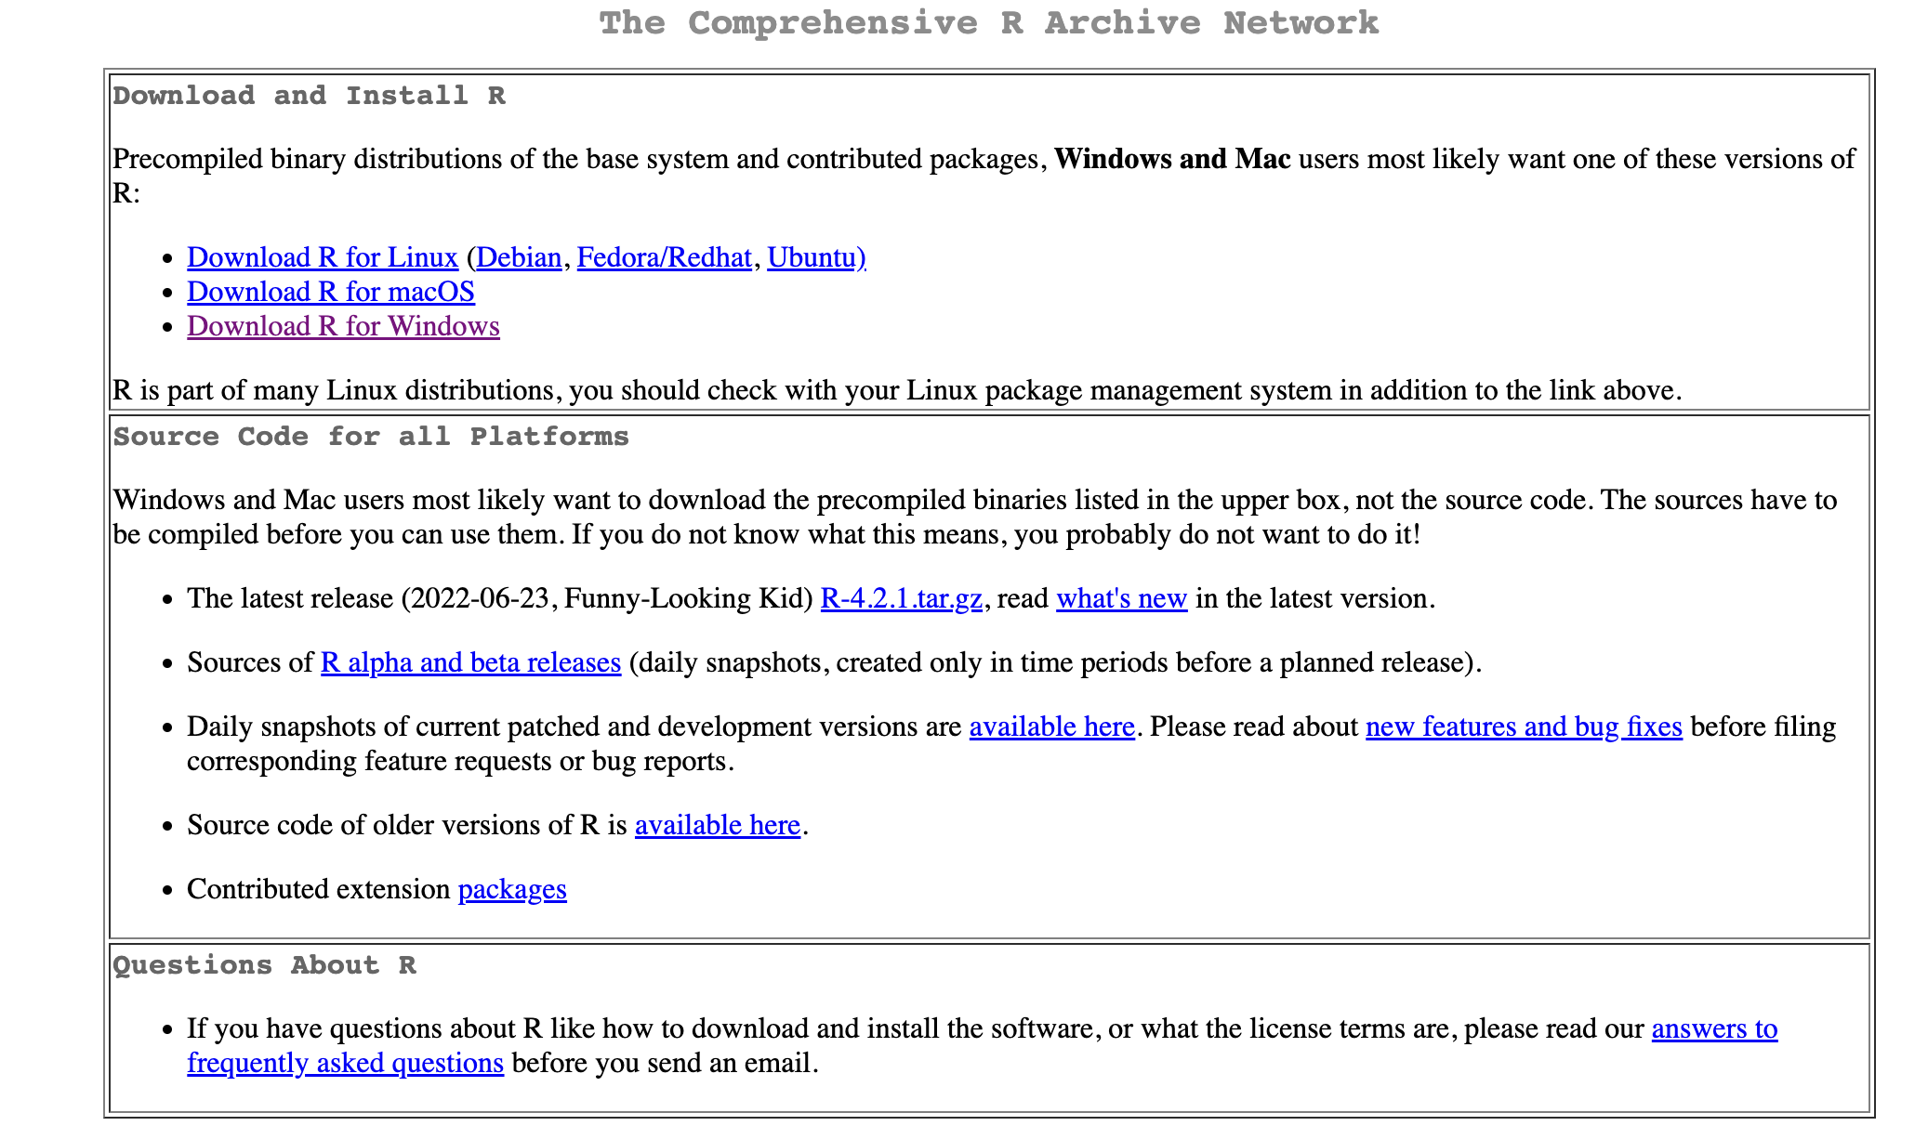
Install R
https://cran.r-project.org/

Slide 5
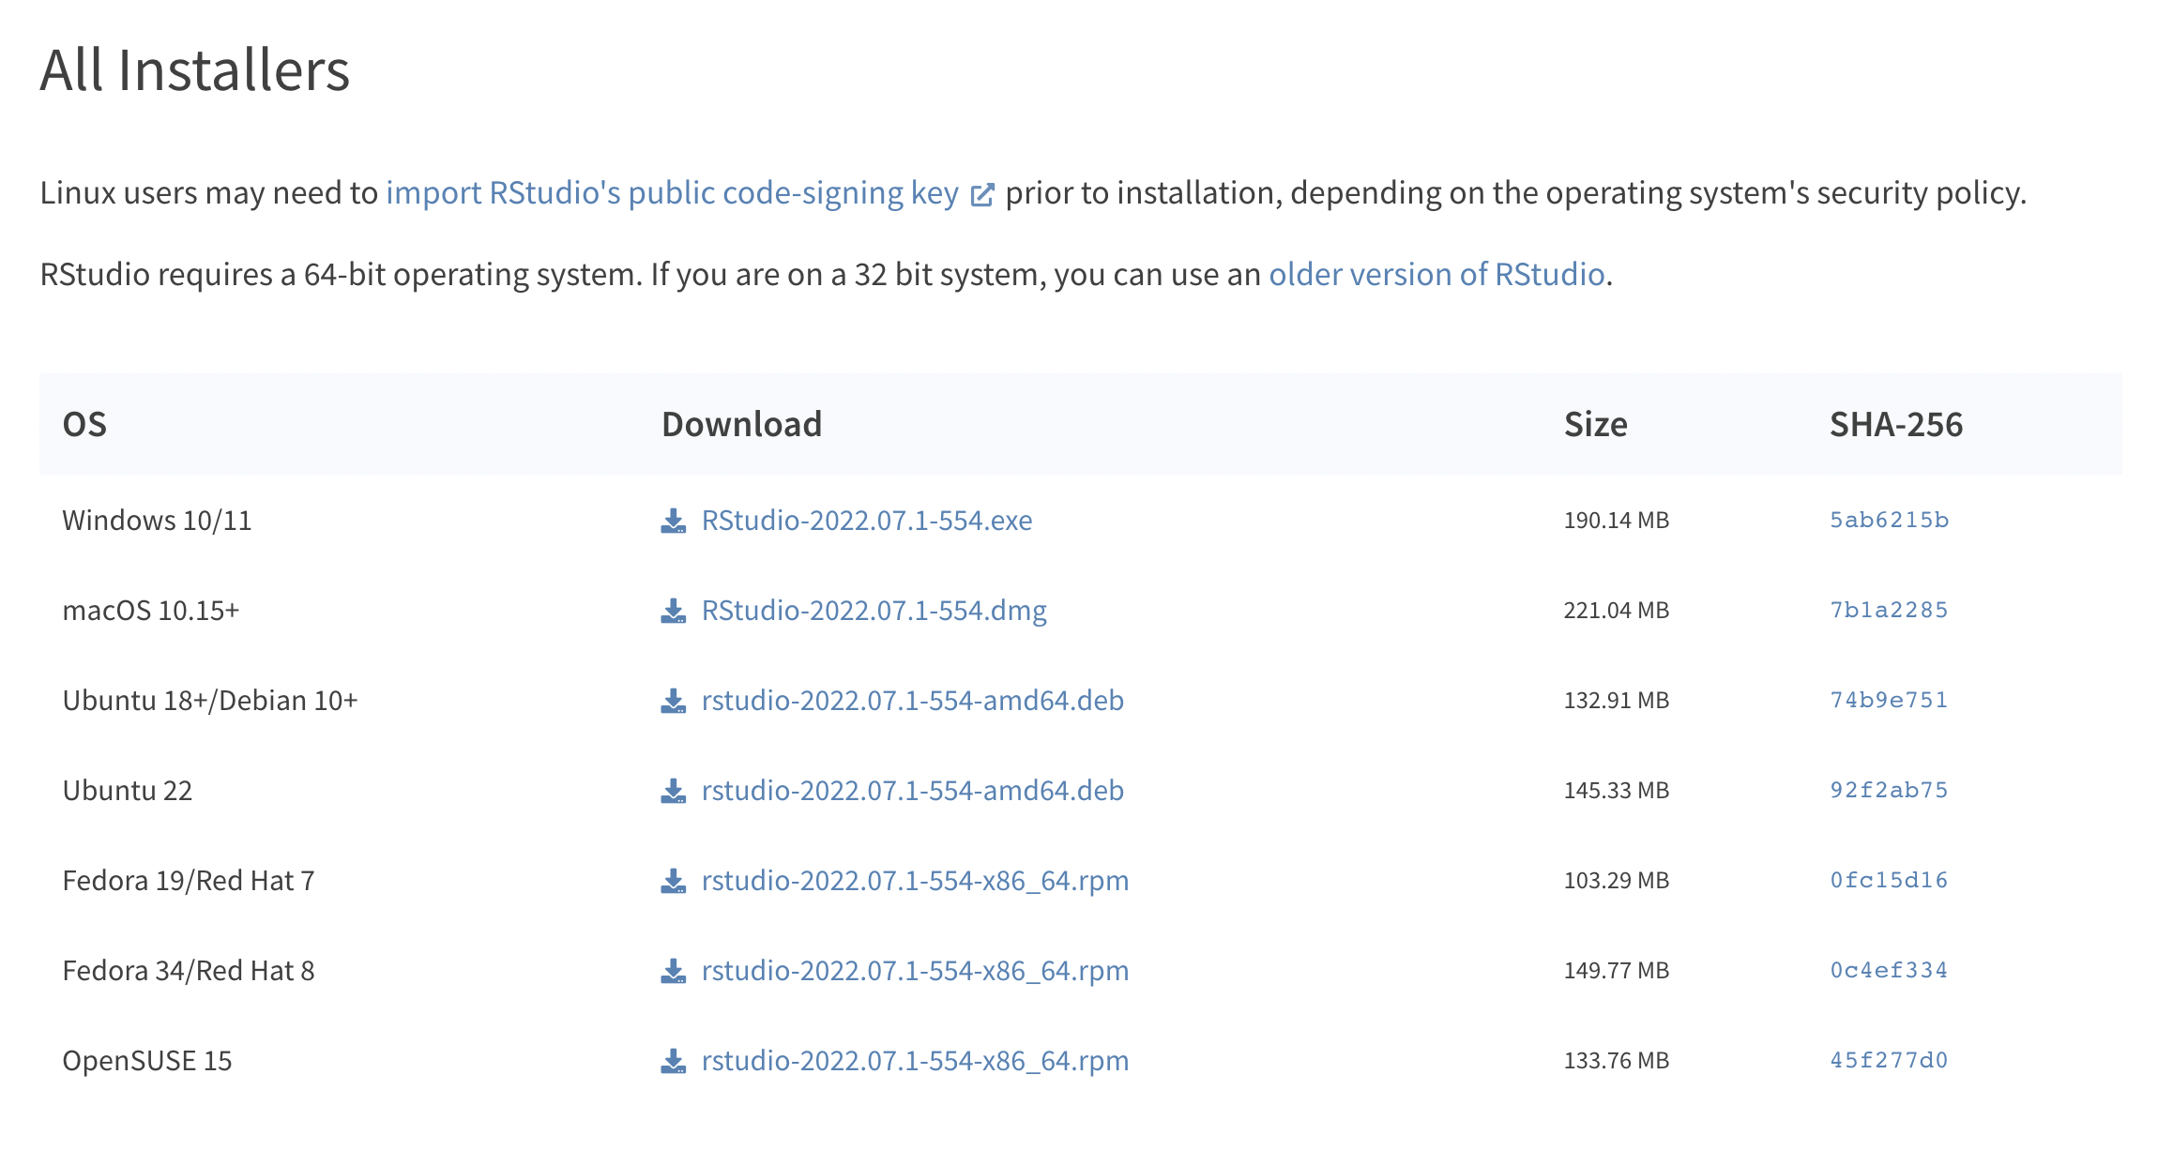
Install R Studio
https://www.rstudio.com/products/rstudio/download/#download

Slide 6
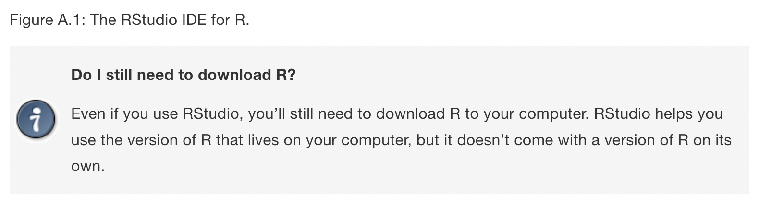
Install R Studio
We need to install both R and R Studio separately.

Slide 7
Data Sets Used in Labs and Exercises
The ISLR package
The MASS library
Base R

Slide 8
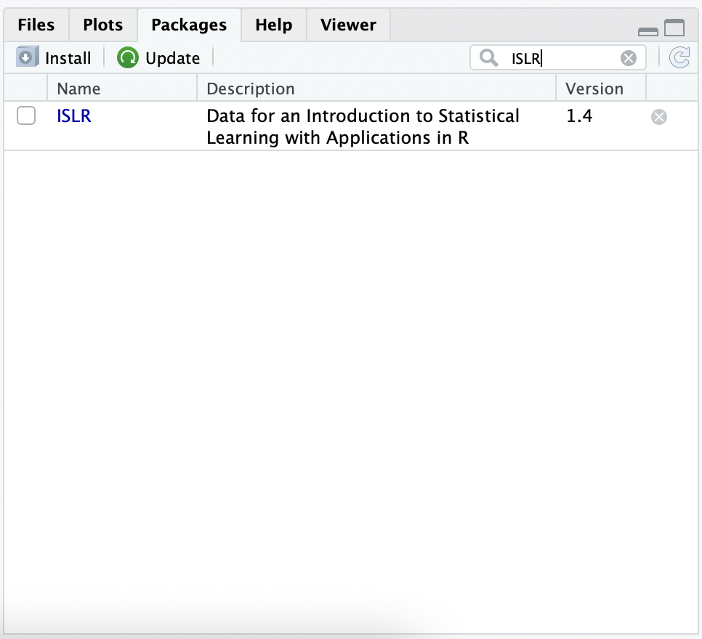
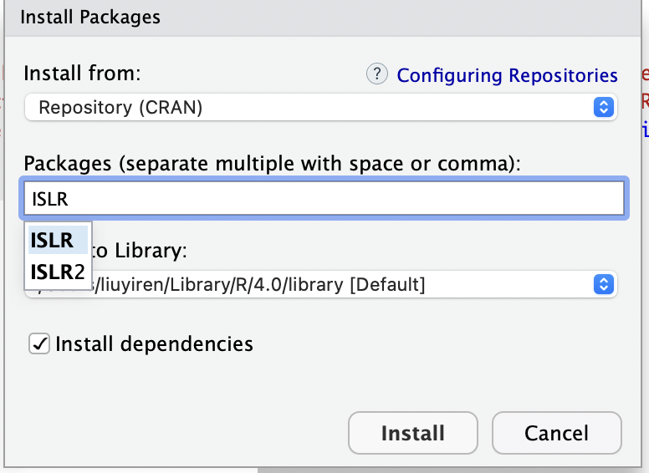
Install ISLR Package
Method1:
install.packages("ISLR")
Method2:

Slide 9
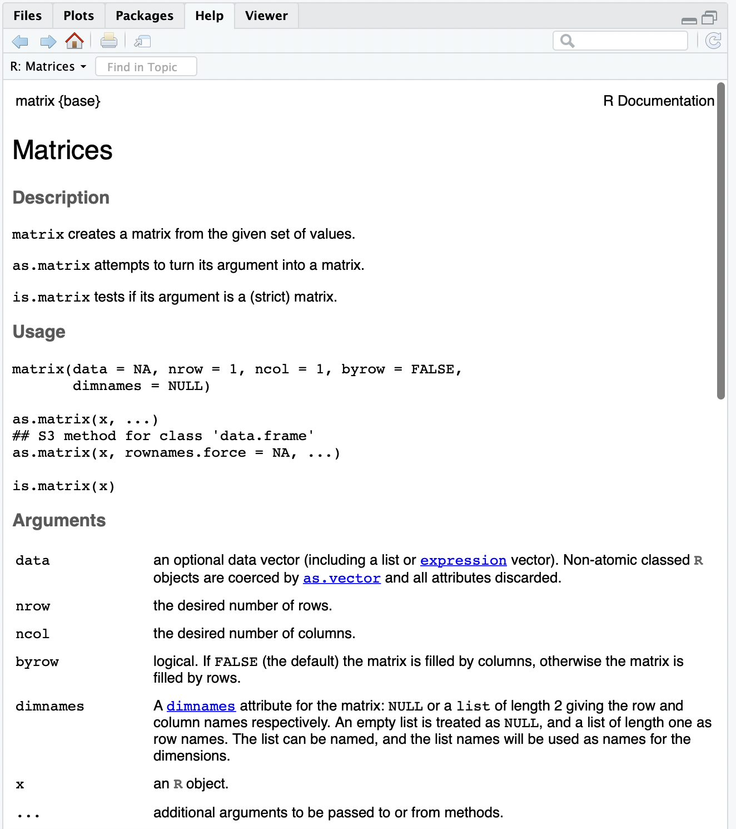
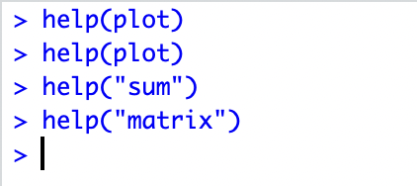
Get Help

Slide 10
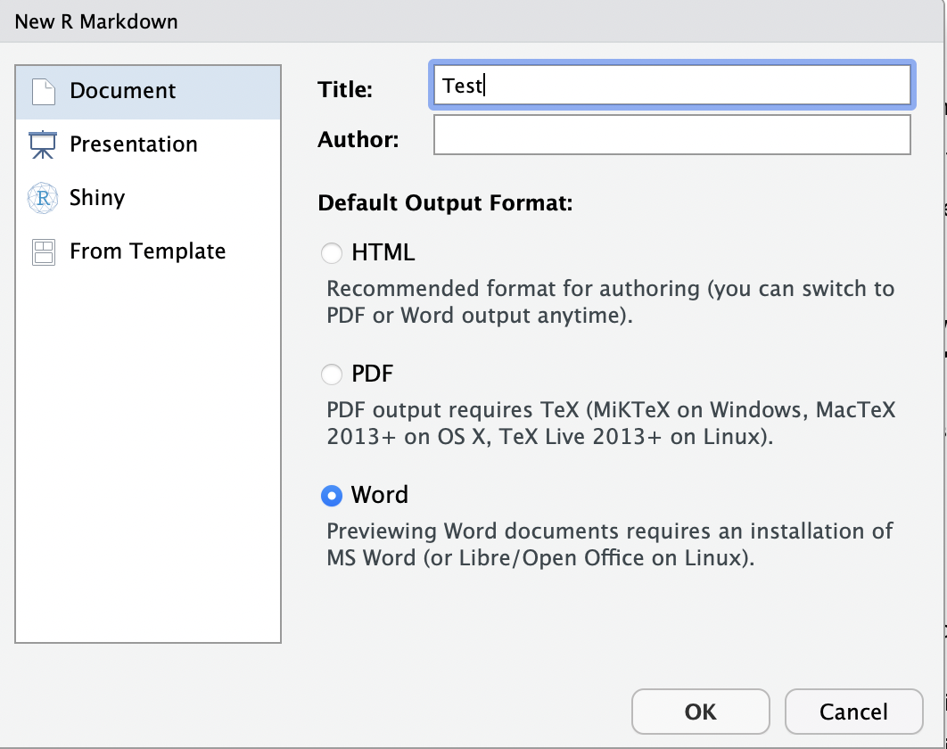
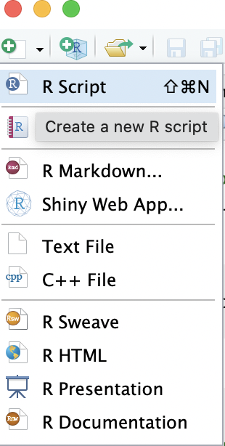
Create Markdown/Script

Slide 11
Basic commands

Slide 12
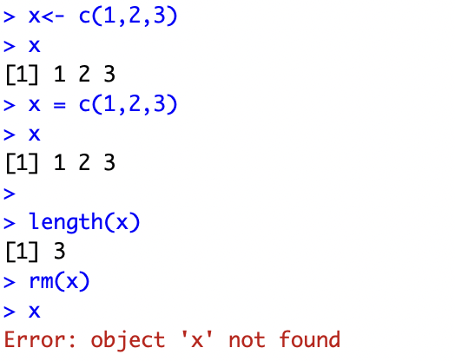
Vector
Save things, use “<-” or “=”
Insert vector using function “c()”
Check length of vector using “length()”
Delete vector: rm(x), Delete all vectors: rm(list = ls())

Slide 13
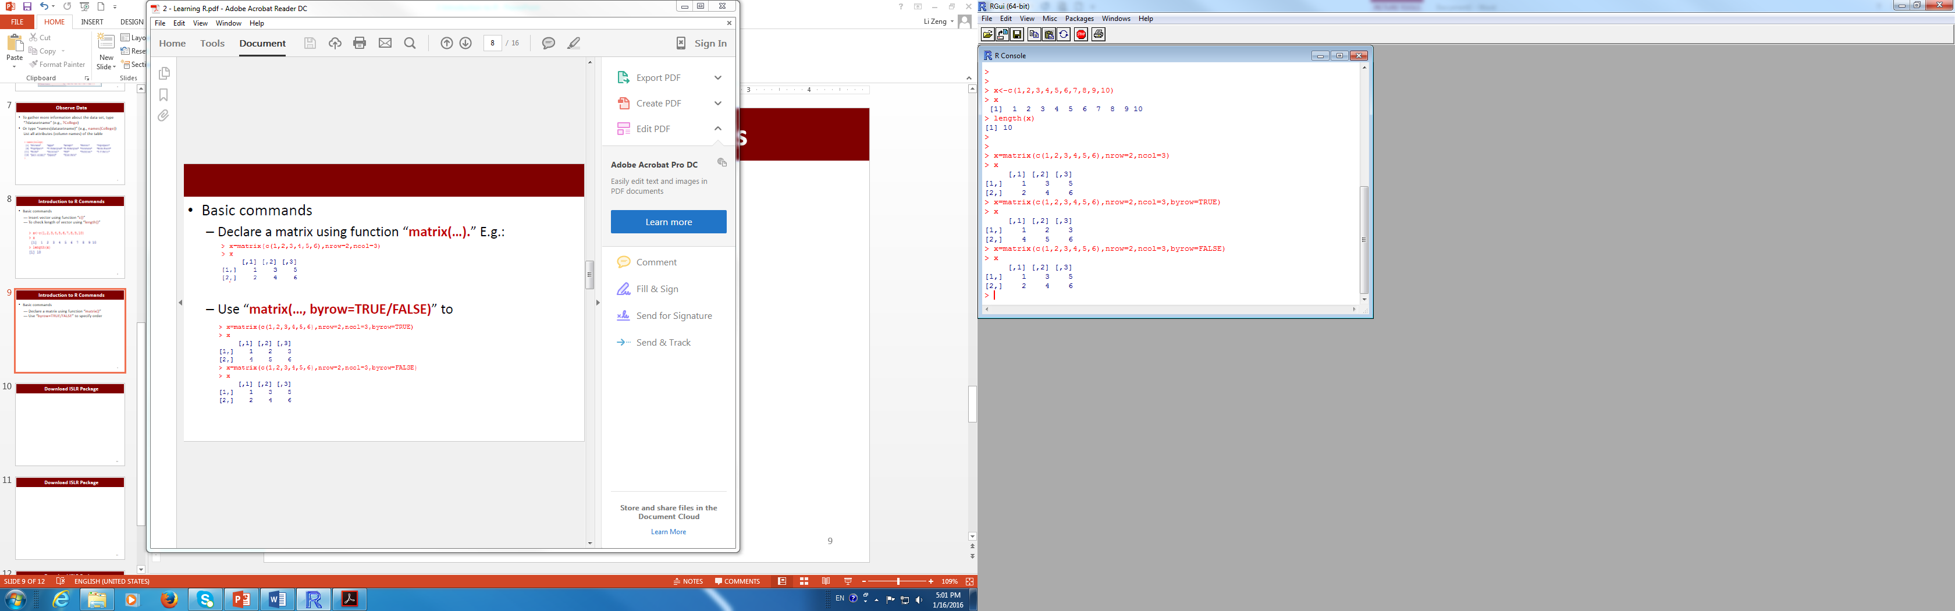
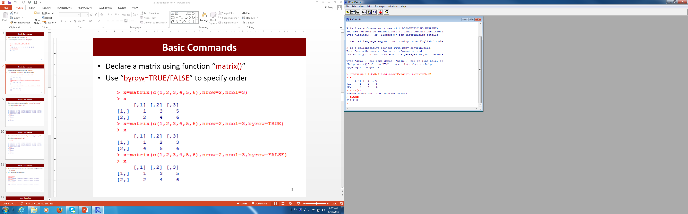
Matrix
Declare a matrix using function “matrix()”
Use “byrow=TRUE/FALSE” to specify order
Use “dim()” to find dimension of a matrix

Slide 14
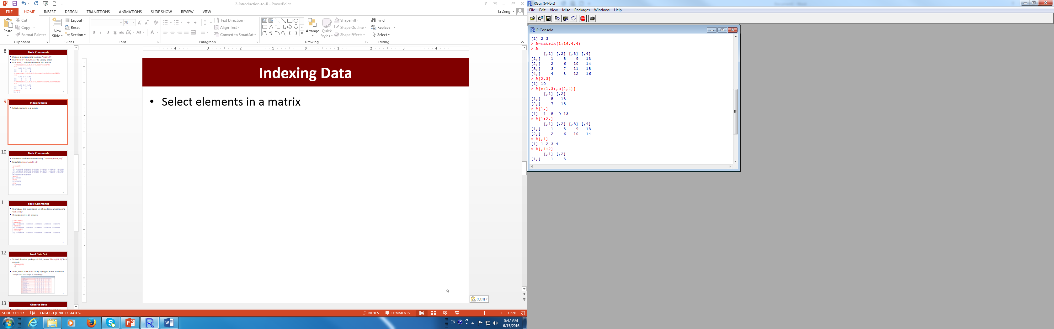
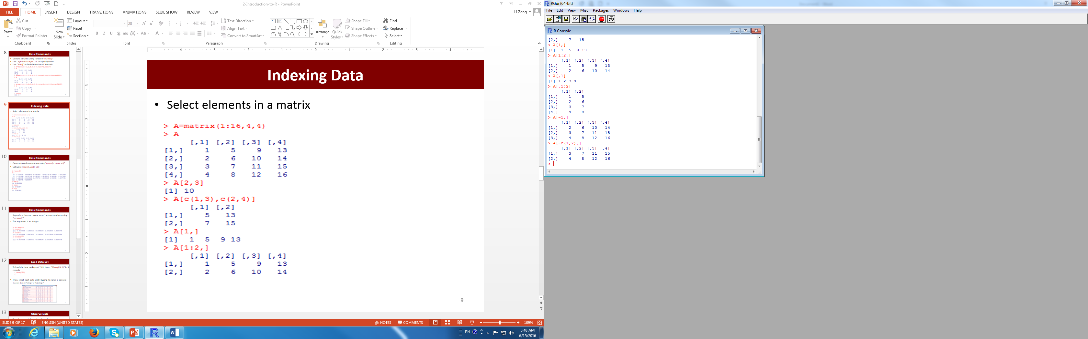
Select Elements in A Matrix

Slide 15
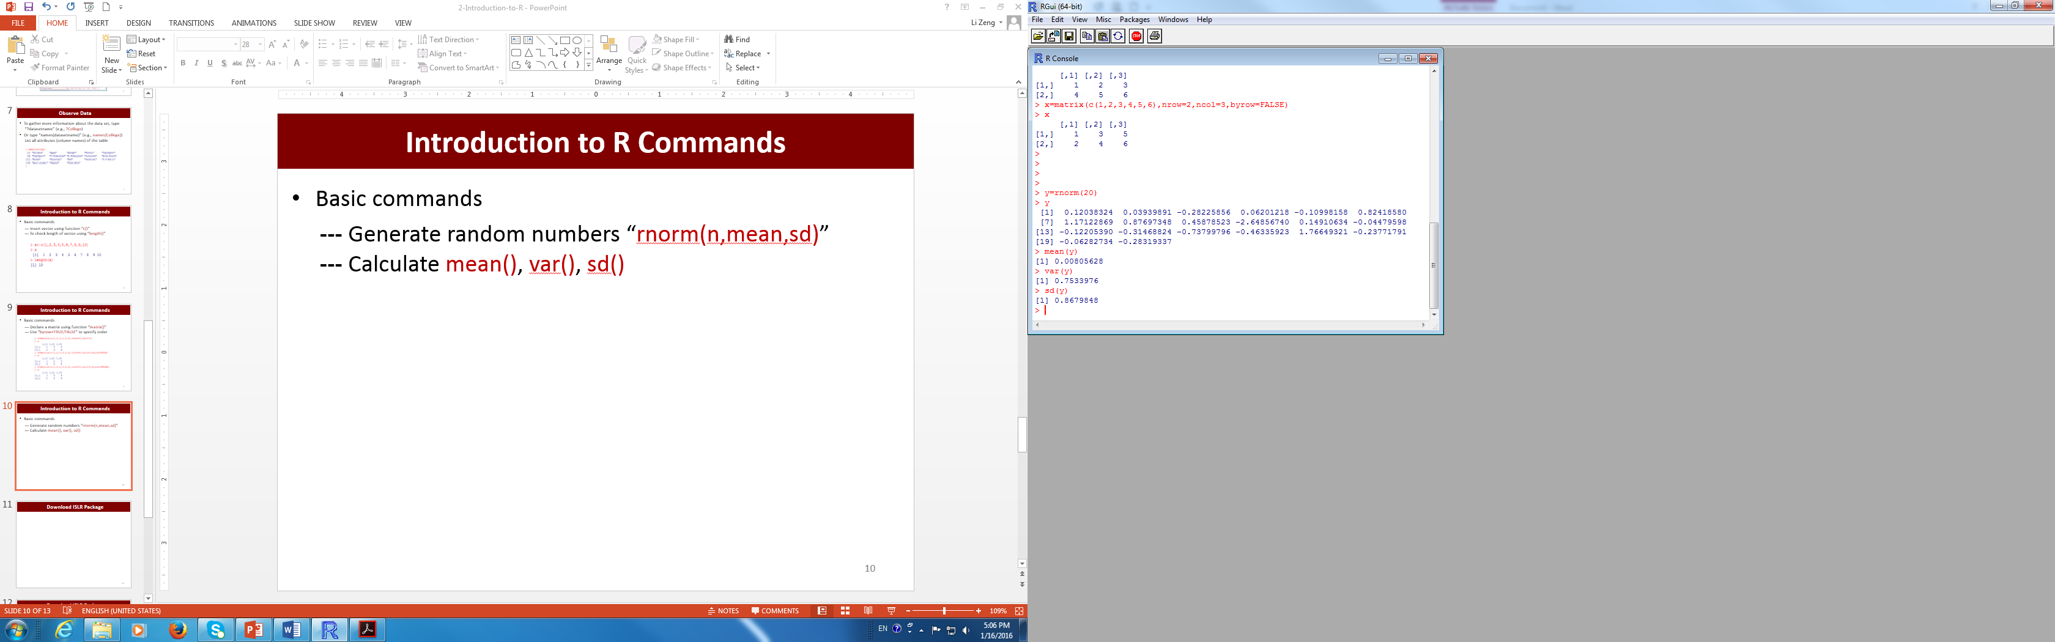
Generate Random Numbers
Generate random numbers from a standard normal distribution using “rnorm(n)”
Calculate mean(), var(), sd() of random numbers

Slide 16
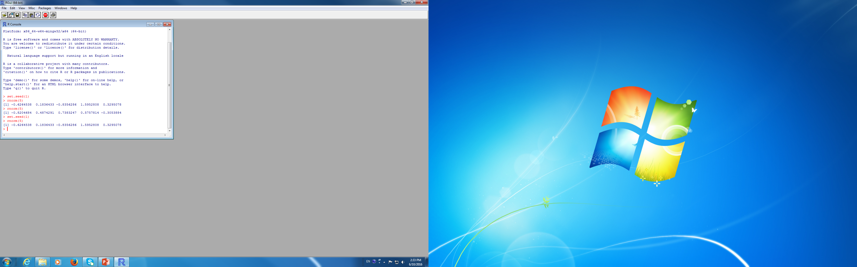
Set the Seed of Random Number Generator
Set the seed of random number generator using “set.seed()”
To reproduce the exact same set of random numbers, use the same seed

Slide 17
Example of preliminary analysis of a dataset

Slide 18
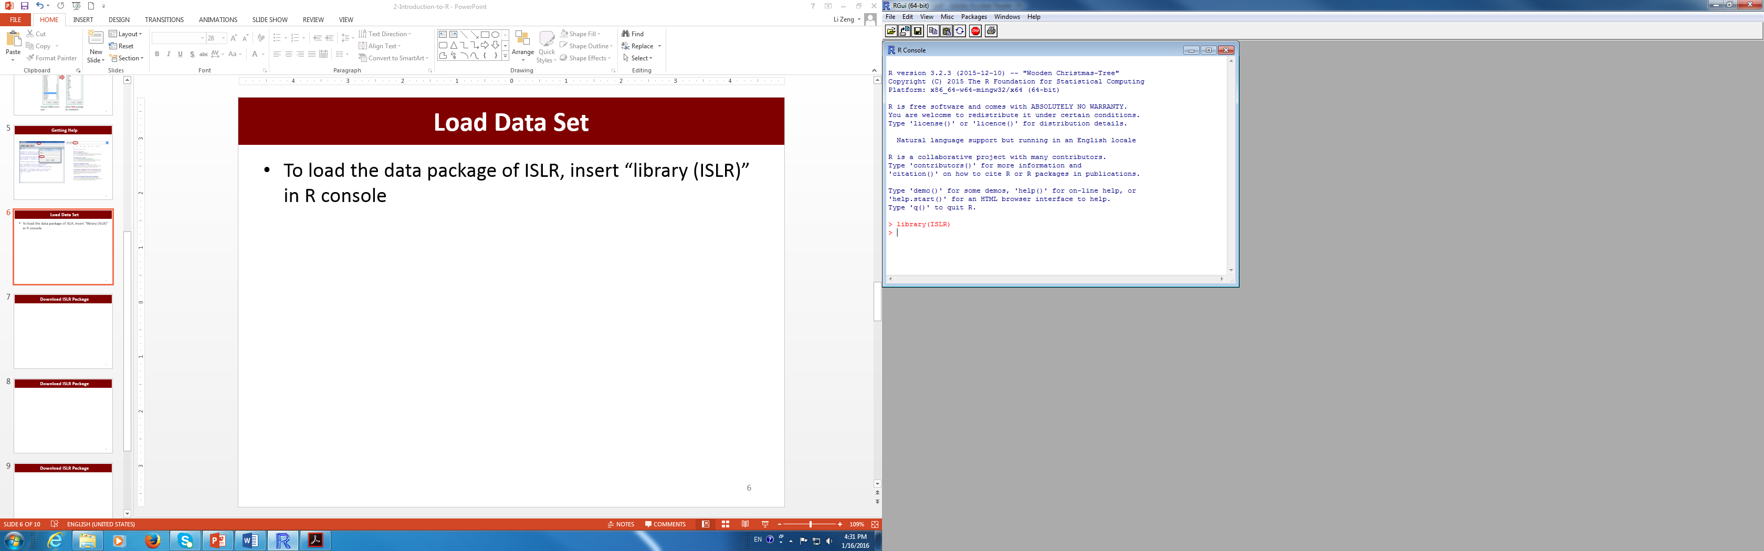
Load Dataset
To load a data set in the ISLR package or other packages/libraries, you only need to load the package
To load an external data set, first specify the directory “File” → “Change dir…”
If the data are saved as a text file
Auto=read.table('Auto.data',header=T,na.strings='?’)
If the data are saved as a csv file (Excel)
stock=read.csv('0001.HK.csv',na.strings='?')

Slide 19
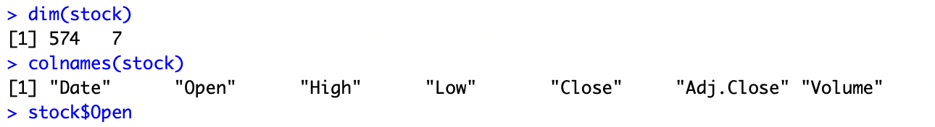
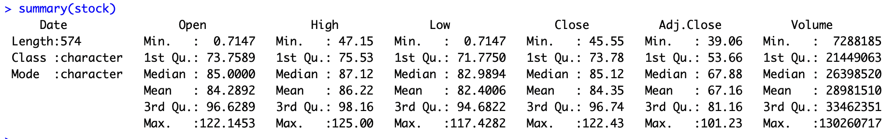
Basic operations of Dataset
Use dim() to check number of row and column
Use colnames() to check column names
Use stock$Open or stock[,’Open’] to view the value of a column
Use stock[1,] to view the first row
Use Summary to get numerical summaries

Slide 20
Plot something
# Plot open price
plot(stock[,'Open'],ylab = c("Open Price"), type = 'l')
grid()
title('HK.0001')
# show open and high price in the same figure
plot(stock[,'Open'],ylab = c("Price"),type = 'l')
lines(stock[,'High'], col = "red")
grid()
legend("topleft",c("Open","High"), lty = 1,col=c("black","red"))
title('HK.0001')
# compare open price and high price
plot(stock[,'Open'],stock[,'High'],xlab = c('Open Price'), ylab = c("High Price"))
grid()
title('HK.0001')

